Slide 1
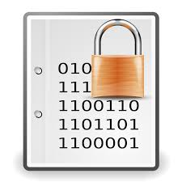
Network Security, TLS, Project 2
CS 118: Computer Networks
George Varghese
Slides from James Stanley, Gene Tsudik, David Wagner,
Jim Kurose, Keith Ross, Cliff Zhou.

Slide 2
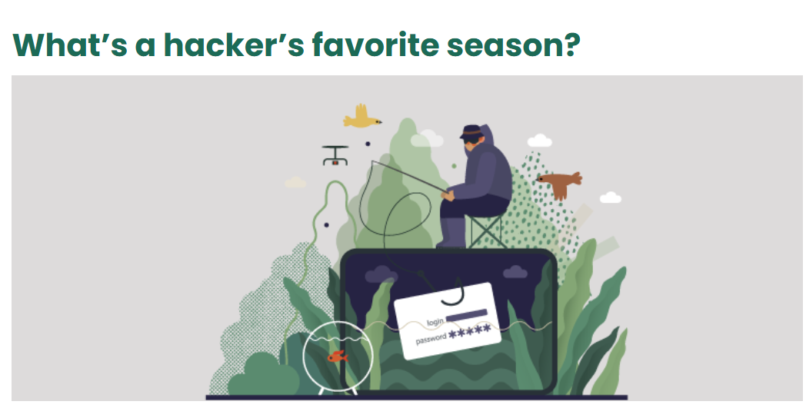
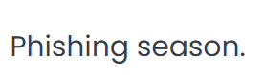
Hacker jokes

Slide 3
Internet requires security
TCP and Project 1 show how to get reliability
Internet routers and links can drop messages
But a huge problem is security
Hackers can read, change messages, claim to be others
Typical Guarantees we would like
Confidentiality, Integrity, Authentication
Who should provide these guarantees
In the past this was done at higher layers in ad hoc ways, but it makes more sense to have a standard at the Transport Layer just above TCP, Transport Layer Security (TLS)
Basis of https and what was called SSL. You will implement a simplified version of TLS in Project 2

Slide 4
Need building blocks first
Encryption
From one time pads to symmetric keys via DES/AES
How public key encryption solves the key exchange problem
How certificates help you trust public keys
Signatures and Message Digests
How RSA can be used to sign messages for authentication
How secure hashes/MACs can help with Integrity
Other tools such as nonces, sequene numbers etc.
Putting it together
TLS
Simplifications in Project 2

Slide 5
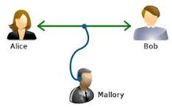
1.Confidentiality and Encryption
@harvard
@princeton
From Wikipedia
@hackerempire

Slide 6
Simplest idea: one time pad
The secret key that sender and receiver have is a long random string (K) of same length as message M
To encrypt, Alice creates cypher-text C as C = M XOR K. Then send via TCP
Even if Mallory can read C, it is essentially random text
When Bob gets it via TCP, Bob recovers M by doing M = C XOR K.
Two questions: how does Bob get K? Can we reuse K on subsequent messages

Slide 7
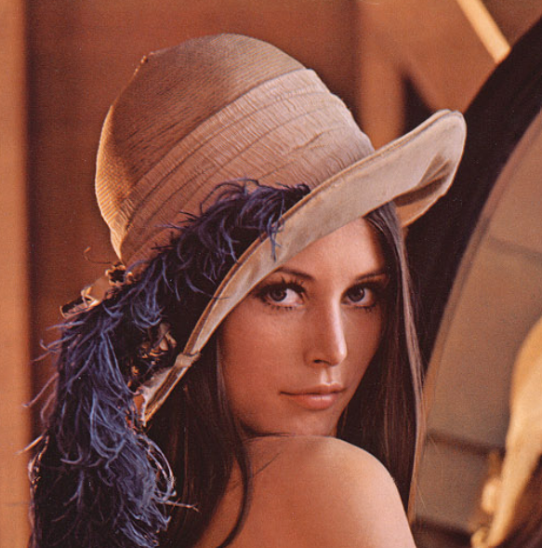


Why one-time pad? (Stanley)
M1
M2

Slide 8
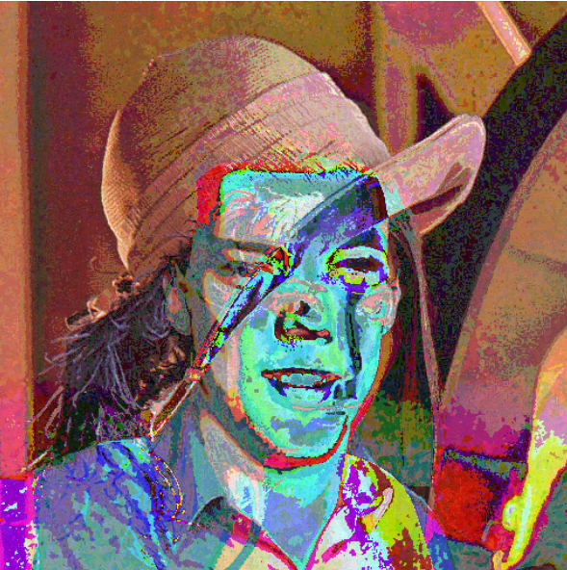
Reuse-> get info from M1, M2
M1
M2
This is because M1 + M2 = L + K + J + K = L + K
(Lena XOR James). The K cancels out!
https://incoherency.co.uk/blog/stories/otp-key-reuse.html

Slide 9
Where does that leave us?
Key Reuse: Cannot reuse the long (1500 byte pad)
Key exchange: Before sending every message, Alice has to securely send the corresponding Key K
The Key Reuse problem is fixed using encryption standards like DES/AES that use a short key of 64 bits that can be reused across Alice’s messages (next)
The Key Exchange problem is solved using public key encryption and certificates (later)

Slide 10
DES/AES
Block Cypher
Breaks message into 64 bit chunks
Uses a sequence of Shift and XORs based on 64-bit key
Based on a basic unit called a Feistel function
Feistel function
Break text into two halves. Right half is combined with key and a Round function (think XOR) and XORed with left half
Do several rounds to encrypt, decryption in reverse order
Luby-Rackoff: if Round function F is pseudo-random, then after 4 rounds of this, we get a pseudorandom permutation
Chaining Modes
Simplest mode: ECB, each block is done independently

Slide 11
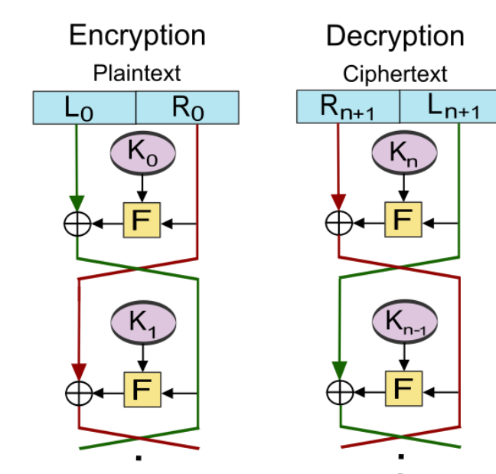
Feistel Function
Really just some complicated sequence of shifts and XORs based on key that has good properties

Slide 12
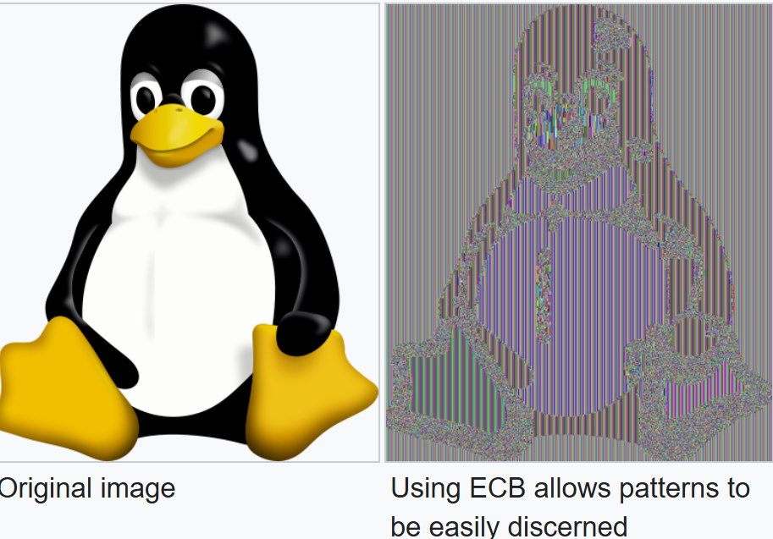
ECB Mode has leakage issues
Problem: same plaintext, same cipher-text
Can see patterns when text is repeated

Slide 13
Better to chain (Project 2)
CBC or Cypher Block Chaining: Each block is XORed with previous block before being encrypted
First block has to be XORed with an initialization vector (IV) that can be sent in the clear
Advantage: no leakage like in previous slide
Disadvantage: Sequential not parallel. Also as in Ethernet, last block may have be padded to be 64 bits
Several other modes allowed by TLS but CBC is quite common

Slide 14
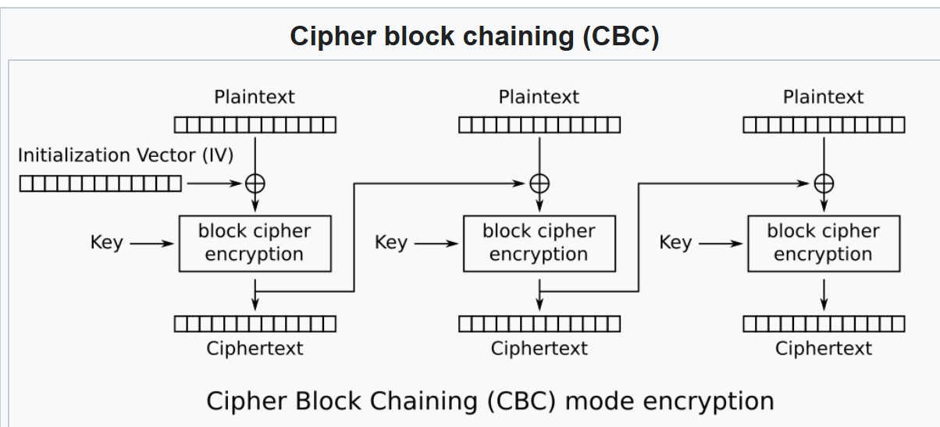
CBC Chaining in Pictures
https://en.wikipedia.org/wiki/Block_cipher_mode_of_operation

Slide 15
Two big standards: DES and AES
DES: Data Encryption Standard
US encryption standard [NIST 1993]
56-bit symmetric key, 64-bit plaintext input
no known “backdoor” decryption approach
Too short for current computing power

Slide 16
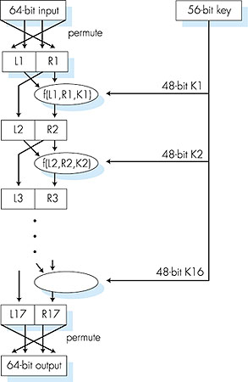
DES: 16 Feistels
DES operation
initial permutation
16 identical “rounds” of function application, each using different 48 bits of key
final permutation

Slide 17
AES: Advanced Encryption Standard
Newer (2001) symmetric-key standard, replacing DES
Processes data in 128 bit blocks
128, 192, or 256 bit keys, harder to break!
Multiple rounds of encryption, also makes it harder to break compared to DES

Slide 18
2.Public Key Encryption, Signatures, Certificates
@harvard
@princeton
From Wikipedia
@hackerempire

Slide 19
Now on to Key Distribution
With DES, Alice and Bob need to share a 64 bit key they can reuse for their TCP connections
That’s great but how does Alice send that to Bob over an insecure Internet
Magic: new idea called Public Key cryptography, Alice has two keys a Public Key and a Secret Key. Alice encrypts using her secret key but Bob decrypts using Alice’s public key which Alice publishes on Internet
Disadvantage: More expensive than DES/AES. Also Hacker Harry can masquerade as Alice and publish his public key pretending to be Alice

Slide 20
Public Key Cryptography
symmetric key crypto
requires sender, receiver know shared secret key
Q: how to agree on key in first place (particularly if never “met”)?
Q: how to hide this key from attacker when there is no secure channel?
public key cryptography
radically different approach [Diffie-Hellman76, RSA78]
sender, receiver do not share secret key
public encryption key known to all
private decryption key known only to receiver

Slide 21


Recall symmetric key cryptography
K
K
AB
AB
plaintext
message, m
encryption
algorithm
ciphertext
decryption
algorithm
plaintext
m = K ( )
K (m)
K (m)
AB
AB
AB
Enc(K_{AB}, m)
symmetric key crypto: Bob and Alice share know same (symmetric) key: K_{AB}
e.g., DES 64-bit key
Q: How do Bob and Alice agree on a key value? Using public key crytpography

Slide 22
By contrast, Public key cryptography
+
Bob’s public
key
K
B
-
Bob’s private
key
K
B
plaintext
message, m
encryption
algorithm
ciphertext
decryption
algorithm
plaintext
message
+
K (m)
-
+
B
m = K (K (m))
B
B

Slide 23
Example: RSA public keys
+
Bob’s public key E, n = p. q
K
B
-
Bob’s private
key D, D.E = 1 mod (p-1) (q-1)
K
B
plaintext
message, m
encryption
algorithm
ciphertext
decryption
algorithm
plaintext
message
c = m^{E} mod n
c^{D} mod n =
(m^{E)D} mod n =
m¹ mod n = m

Slide 24
RSA Small Example
Suppose Bob selects the primes p=11 and q = 17 q=17, along with e = 3
Bob calculates n = p.q = 11.17 = 187 and ϕ(n)=(p−1)(q−1)=10⋅16=160. Bob calculates d=107, since d .e = 321 and 321≡1(mod ϕ(n)).
Bob distributes public key: n=187 and e = 3
Now suppose Alice wants to send the message "HELLO“ character by character. “H” = 72 in ASCII. Alice calculates m =72³ ≡183 (mod187)
Bob calculates 183¹⁰⁷ mod 187 = 72 back to “H”!

Slide 25
Another important property
This property is very useful for
authentication:
-
+
+
-
K (K (m)) = m
=
K (K (m))
B
B
B
B
use public key first, followed by private key
use private key first, followed by public key
Result is the same!

Slide 26
Digital Signatures
Simple digital signature for message m:
Bob signs m by encrypting with his private key K_{B}, creating “signed” message, K_{B}(m)
-
-
Bob’s message, m
-
Bob’s private
key
-
K
K
(m)
B
B
Dear Alice
Oh, how I have missed you. I think of you all the time! …(blah blah blah)
Bob
Bob’s message, m, signed (encrypted) with his private key
Public key
encryption
algorithm

Slide 27
Message Digests
large
message
m
H: Hash
Function
Computationally expensive to public-key-encrypt long messages
Goal: fixed-length, easy- to-compute digital “fingerprint”
apply hash function H to m, get fixed size message digest, H(m).
H(m)
Hash function properties:
many-to-1
produces fixed-size msg digest (fingerprint)
given message digest x, computationally infeasible to find m such that x = H(m)

Slide 28
Crypto Hash Functions
MD5 hash function widely used (RFC 1321)
computes 128-bit message digest in 4-step process.
arbitrary 128-bit string x, appears difficult to construct msg m whose MD5 hash is equal to x.
SHA-1 is also used.
US standard [NIST, FIPS PUB 180-1]
160-bit message digest
Both considered broken today and folks have moved on to SHA-2, 3 and Blake

Slide 29
Digital signature = signed message digest
Bob sends digitally signed message:
Alice verifies signature and integrity of digitally signed message:
large
message
m
H: Hash
function
encrypted
msg digest
H(m)
-
K_{B}(H(m))
Bob’s
private
key
digital
signature
(encrypt)
large
message
m
-
Bob’s
public
key
digital
signature
(decrypt)
K
B
+
H: Hash
function
K
encrypted
msg digest
B
+
-
K_{B}(H(m))
H(m)
H(m)
No confidentiality !
equal
?

Slide 30
Message Authentication Code (MAC, not MAC address!!)
Message Digest (like SHA-2): a hash that guarantees data integrity only as its hard to find tampered data that has same hash
Message Authentication Code: as used in TLC provides both integrity and authenticity as it uses a shared secret key unlike a Message Digest
One common MAC is HMAC, MACs are used heavily in TLS

Slide 31
Trusted Intermediaries
Public key problem:
When Alice obtains Bob’s public key (from web site, e-mail, diskette), how does she know it is Bob’s public key, not Trudy’s?
Solution:
trusted certification authority (CA)

Slide 32
Certification Authorities
Certification authority (CA): binds public key to particular entity, E.
E (person, router) registers its public key with CA.
E provides “proof of identity” to CA.
CA creates certificate binding E to its public key.
certificate containing E’s public key digitally signed by CA – CA says “this is E’s public key”
-
+
K
(K )
digital
signature
(encrypt)
CA
B
Bob’s
public
key
+
K
+
B
K
B
CA
private
key
certificate for Bob’s public key, signed by CA
Bob’s
identifying information
-
K
CA

Slide 33
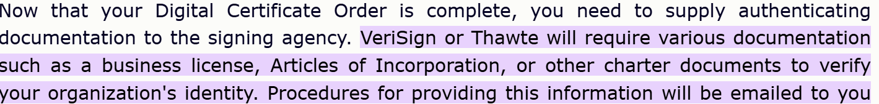
Verifying Identity Offline
A company needs to verify its identity using physical documents and humans just once to get a certificate

Slide 34
Certification Authorities
When Alice wants Bob’s public key:
gets Bob’s certificate (Bob or elsewhere).
apply CA’s public key to Bob’s certificate, get Bob’s public key
-
+
+
K
(K )
digital
signature
(decrypt)
Bob’s
public
key
K
CA
B
B
+
K
B
CA
public
key
+
K
CA

Slide 35
Finally: defend against replay attacks
A simple attack is to replay a old request say to send a million dollars
Defend using nonces (a number never used before, typically a large random number) or a sequence number that will be encrypted
Now we have all the pieces needed for building TLS: symmetric key encryption, public key encryption, certificates, MACs, nonces and sequence numbers

Slide 36
3.Ready or not, here comes TLS
@harvard
@princeton
From Wikipedia
@hackerempire

Slide 37
How should apps use security?
Application
Application
Security
Transport
Transport
Network
Network
normal application
secure application
Would be nice to provide an API to applications
Useful to have security layer above transport
37
Slide from Gene Tsudik, UCI

Slide 38
TLS/SSL in our stack so far
Application
Application
TLS/SSL
TCP
TCP
IP
IP
normal application
application with TLS/SSL
TLS/SSL provides application programming interface (API) to applications
C and Java libraries/classes readily available
Ex: OpenSSL
38
Slide from Gene Tsudik, UCI

Slide 39
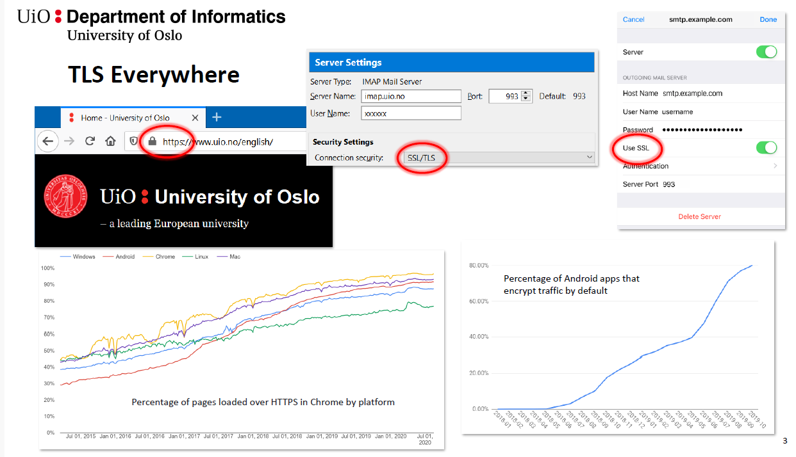
If you use https, you use TLS
Slides from UIO: IN 3210

Slide 40
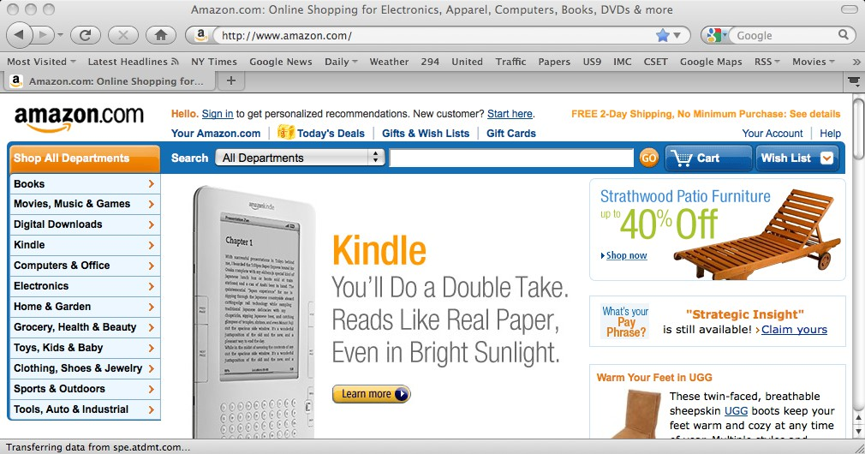
Regular web surfing - http: URL
But if we click here …
Slides from Dave Wagner, UCB

Slide 41
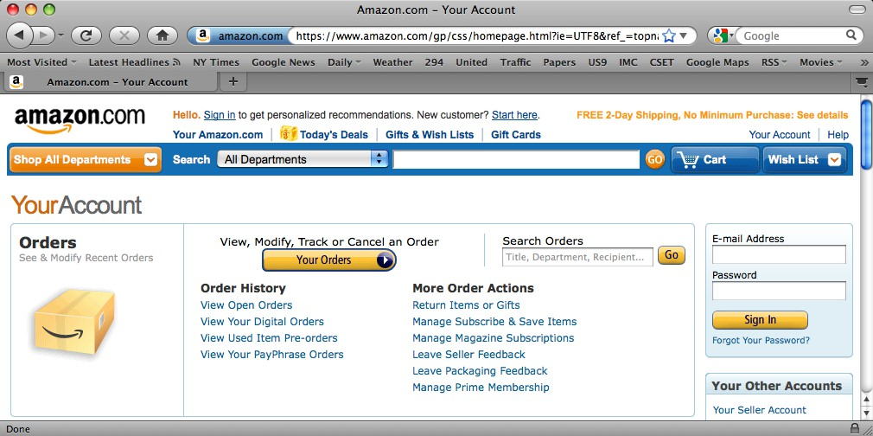
Web surfing with TLS/SSL - https: URL
Note: Amazon makes sure that all of these images, etc., are now also fetched via https: URLs.
Doing so gives the web page full integrity, in keeping with end-to-end security.
Slides from Dave Wagner, UCB

Slide 42
Basic idea
Amazon Server
Browser (client) picks some symmetric keys for encryption+ authentication
Client sends them to server, encrypted using RSA public-key encryption
Both sides send MACs
Now they use these keys to encrypt and authenticate all subsequent messages, using symmetric-key crypto
Browser
E
(keys)
KA
MAC
(…)
k1
MAC
(…)
k2
E
k3
(message), MAC
k1
(…)
Slides from Dave Wagner, UCB

Slide 43
TLS/SSL Cipher Options
Cipher suite
public-key algorithm
symmetric encryption algorithm
Integrity hashing algorithm
TLS/SSL supports several cipher suites
Negotiation: client, server agree on cipher suite
client offers choices
server picks one
Common symmetric ciphers
AES – Advanced Encryption Standard
DES – Data Encryption Standard: block
3DES – Triple strength: block
SSL Public key encryption
RSA with DH
Integrity hashing algorithms
HMAC-MD5 and others
Slides from Dave Wagner, UCB

Slide 44
HTTPS Connection (SSL / TLS)
Amazon Server
Browser (client) connects via TCP to Amazon’s HTTPS server
Client picks 256-bit random number R_{B}, sends over list of crypto protocols it supports
Server picks 256-bit random number R_{S}, selects protocols to use for this session
Server sends over its certificate
(all of this is in the clear)
Client now validates cert
Browser
SYN
SYN ACK
ACK
Hello.
My rnd # = R
B
(TLS+RSA+AES128+SHA1) or
(SSL+RSA+3DES+MD5) or
. I support
…
.
Let’s use
My rnd # = R
S
TLS+RSA+AES128+SHA1
Here’s my cert
Slides from Dave Wagner, UCB
~2-3 KB of data

Slide 45
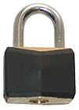
HTTPS Connection (SSL / TLS), with RSA continued
Amazon
For RSA, browser constructs
“Premaster Secret” PS
Browser sends PS encrypted using Amazon’s public RSA key K_{Amazon}
Using PS, R_{B}, and R_{S}, browser & PS
server derive symm. cipher keys (C_{B}, C_{S}) & MAC integrity keys (I_{B}, I_{S}) – One pair to use in each direction
Browser & server exchange MACs computed over entire dialog so far
If good MAC, Browser displays
All subsequent communication encrypted w/ symmetric cipher (e.g.,AES128) cipher keys, MACs
– Sequence #’s thwart replay attacks
Server
Browser
Here’s my cert
~2-3 KB of data
{PS}
K
Amazon
PS
MAC(dialog,I )
B
S
MAC(dialog,I )
{M
1
, MAC(M
,I
)}
1
B
C_{B}
,I
)}
, MAC(M
2
S
C_{S}
{M
2
Slides from Dave Wagner, UCB

Slide 46
Alternative: Key Exchange via Diffie-Hellman
Amazon Server
For Diffie-Hellman, server generates random a, sends public params and gª mod p
– Signed with server’s private key
Browser verifies signature
Browser generates random b, computes PS = g^{ab} mod p, sends to server
Server also computes
PS = g^{ab} mod p
Remainder is as before: from PS, R_{B}, and R_{S}, browser & server derive symm. cipher keys (C_{B}, C_{S}) and MAC integrity keys (I_{B}, I_{S}), etc…
Browser
Here’s my cert
~2-3 KB of data
mod p}
-1
Amazon
{g, p, g
a
K
PS
g
b
mod p
MAC(dialog,I )
PS
B
S
MAC(dialog,I )
{M
1
, MAC(M
,I
)}
1
B
C_{B}
…

Slide 47
TLS Protections (Dave Wagner)
Attacker runs a sniffer to capture our WiFi session?
(maybe by breaking crummy WEP security)
But: encrypted communication is unreadable
No problem!
DNS cache poisoning?
Client goes to wrong server
But: detects impersonation - No problem!
Attacker hijacks our connection, injects new traffic
But: data receiver rejects it due to failed integrity check No problem!
Slides from Dave Wagner, UCB

Slide 48
TLS Protections, continued
DHCP spoofing?
Client goes to wrong server
But: detects impersonation -- No problem!
Attacker manipulates routing to run us by an eavesdropper or take us to the wrong server?
But: they can’t read; we detect impersonation No problem!
Attacker slips in as a Man In The Middle?
But: they can’t read, they can’t inject
Can’t even replay previous encrypted traffic - No problem!
Slides from Dave Wagner, UCB

Slide 49
Project 2
Course is about big ideas and real code. So not enough to talk about TLS. Project 2 will ask you to implement a simple version using lots of framework and building on Project 1 (our simplified TCP)
Things to know: Attend discussion this Friday for more help. But involves cypher block chaining and so need Initialization Vector and Padding and Diffie-Hellman
Missing: All the complex negotiation etc. Start early but its due on last week so around 200 LOC to do it but need to understand what to do

Slide 50
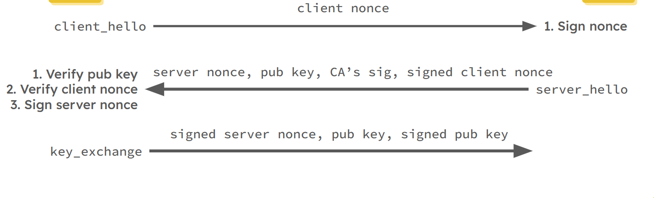
Project 2: Initial Handshake
CLIENT
SERVER

Slide 51
Summary
TLS, Transport Level Security
Uses all the building blocks: AES, RSA,MACs, sequence numbers, nonces
Layer above TCP, extra round trips, today combined in Google’s QUIC (later)
Project 2
Very simplified version of TLS with a lot of framework code already added
Hard part is to understand the big picture to write a fairly small amount of code

Slide 52
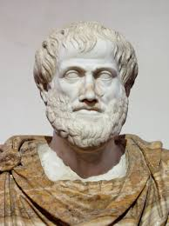
Epilog: Aristotle on searching
The search for truth is in one way hard and in another way easy, for it is evident that no one can master it fully or miss it wholly. But each adds a little to our knowledge of nature, and from all the facts assembled there arises a certain grandeur - Aristotle

